Slide 1
Gesture Recognition based on PyTorch
Runlin Hou
Sifan Yuan
Yuxiang Song
Haocong Wang

Slide 2
Background
Gesture recognition is a topic in computer science and language technology with the goal of interpreting human gestures to computers via mathematical algorithms.
Gesture recognition can be seen as a way for computers to begin to understand human body language, thus building a richer bridge between machines and humans than primitive text user interfaces or even GUI.
Notes:
Gesture recognition is a topic in computer science and language technology with the goal of interpreting human gestures via mathematical algorithms.[1] Gestures can originate from any bodily motion or state but commonly originate from the face or hand. Current[when?] focuses in the field include emotion recognition from face and hand gesture recognition. Users can use simple gestures to control or interact with devices without physically touching them. Many approaches have been made using cameras and computer vision algorithms to interpret sign language. However, the identification and recognition of posture, gait, proxemics, and human behaviors is also the subject of gesture recognition techniques.[2] Gesture recognition can be seen as a way for computers to begin to understand human body language, thus building a richer bridge between machines and humans than primitive text user interfaces or even GUIs (graphical user interfaces), which still limit the majority of input to keyboard and mouse and interact naturally without any mechanical devices. Using the concept of gesture recognition, it is possible to point a finger at this point will move accordingly. This could make conventional input on devices such and even redundant.

Slide 3
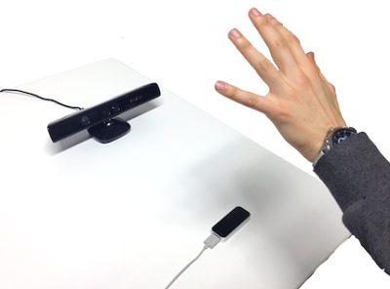
Application
Automotive sector
Consumer electronics sector
Transit sector
Gaming sector
To unlock smartphones

Slide 4

PyTorch
PyTorch is an open source machine learning library based on the Torch library
Primarily developed by Facebook's AI Research lab (FAIR).
Why PyTorch?
Quick start
The code is concise and flexible;
Convenience to debug;
Many developers;
Backed up big tree.

Slide 5
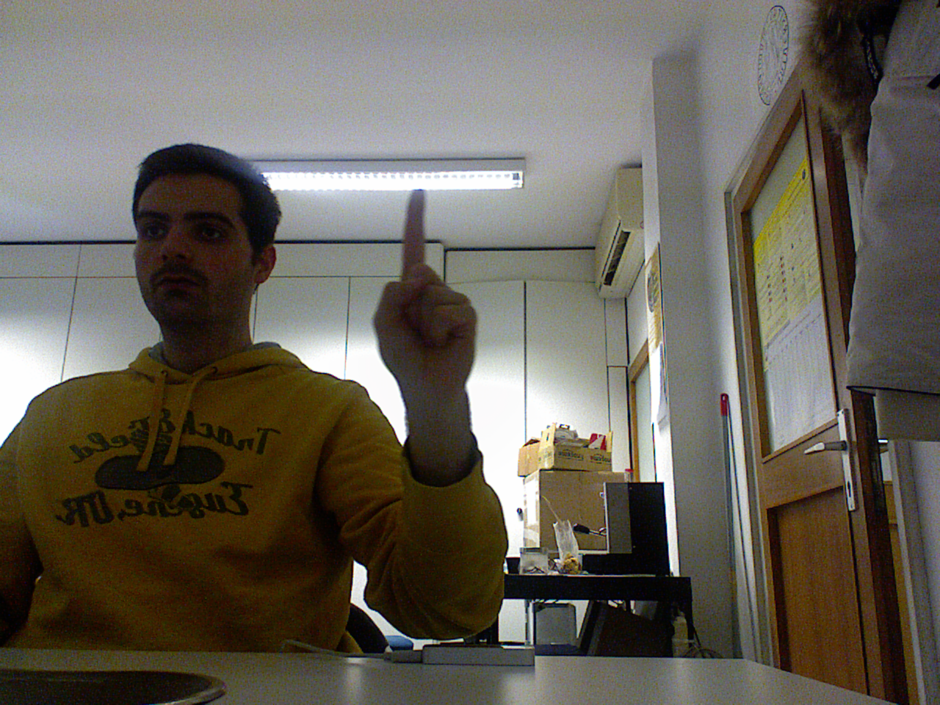
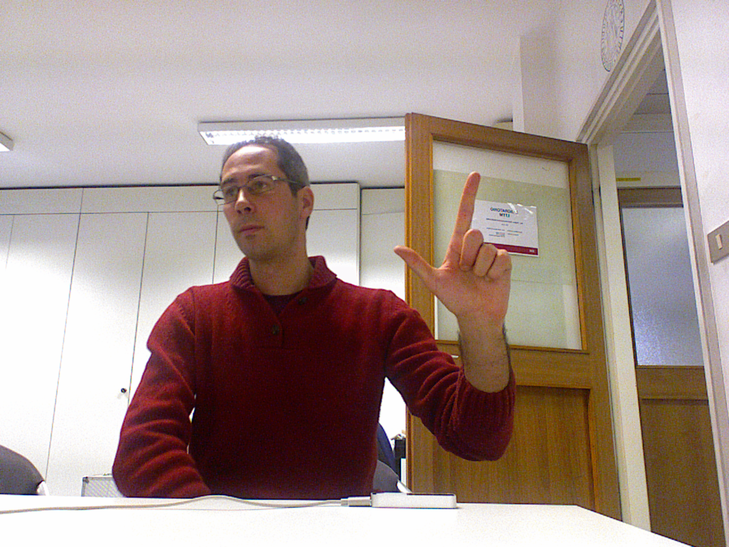
Dataset-1
Microsoft Kinect and Leap Motion
Label: repetition of number from 1-10

Slide 6
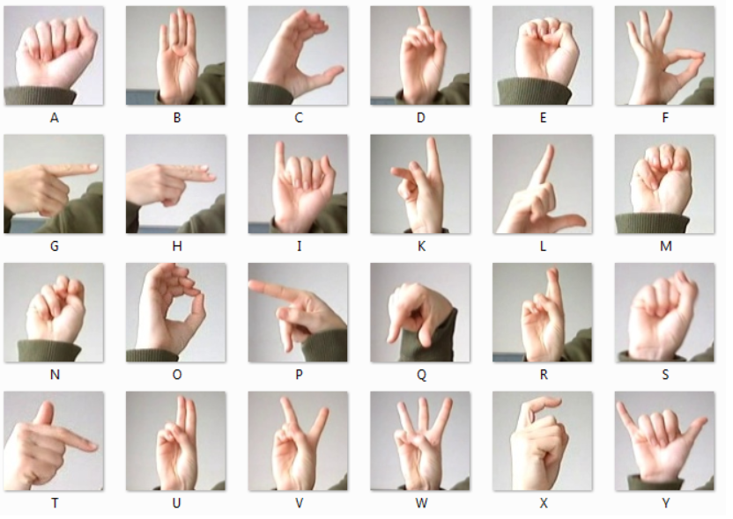
Dataset-2
Sign Language MNIST
Label: letters from A-Z
(without J and Z)

Slide 7
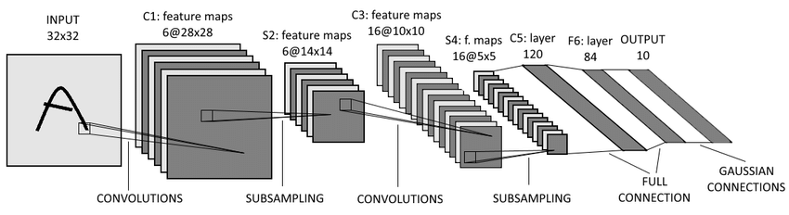
Neural Network Model
LeNet

Slide 8
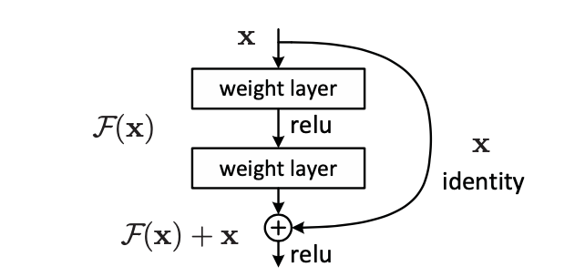
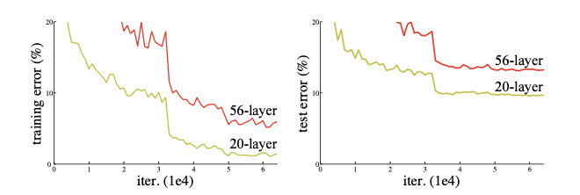
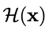
ResNet
Degradation Problem
Residual Learning Block

Slide 9
Target
Our final target is to make the machine have the ability to recognize the meaning of each gesture shown in the images.
Furthermore, depending on complexity and time consumption, we would like to identify the skeleton of each hand. Some thoughts to achieve that would be signing those points in image with high weights.

Slide 10
Reference
G. Marin, F. Dominio, P. Zanuttigh, "Hand gesture recognition with Leap Motion and Kinect devices", IEEE International Conference on Image Processing (ICIP), Paris, France, 2014
G. Marin, F. Dominio, P. Zanuttigh, "Hand Gesture Recognition with Jointly Calibrated Leap Motion and Depth Sensor", Multimedia Tools and Applications, 2015

Slide 11
Thank you.

